Slide 1
Exploring Simulator Options for MDOT Maintenance and Transit Operator Training
MSU CAVS: Daniel Carruth, John McGinley MDOT: Cindy Smith, Rhea Vincent

Slide 2
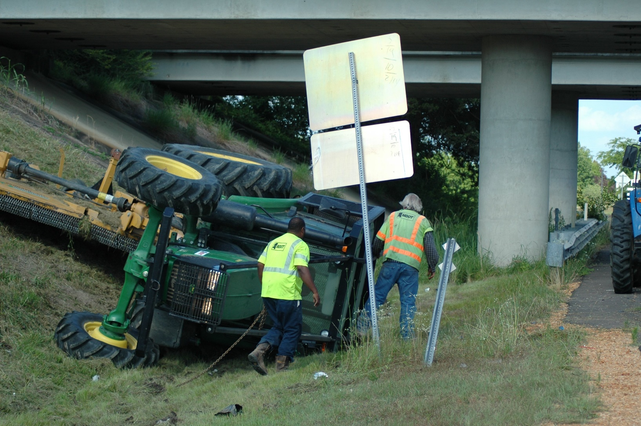
A quick story…

Slide 3
MSU-CAVS / MDOT Project Objectives
Task 1: Literature Review
Task 2: Review of Simulation Use (DOTs)
Task 3: Review of Simulation Use (Industry)
Task 4: MDOT requirements
Task 5: Vendor Discussions

Slide 4
Task 1: Literature Review
Over 30 papers reviewed
Information synthesized in a matrix of topic areas
Simulation fidelity, application areas, effectiveness in training, best practices, previously published reviews
Findings
Performance metrics increased in simulation
Difficult to assess real world impact
Transit Cooperative Research Program Report 72: Simulators and Bus Safety: Guidelines for Acquiring and Using Transit Bus Operator Driving Simulators. (2001)

Slide 5
Transit: Literature Review
Some evidence for effectiveness
Reported effects
Operational costs <10% of training with real buses
Reduced length of training (by 2-5 days)
Potential revenue in providing training to other agencies
10-60% reduction in collisions
30-50% reduction in dropouts, course failures during training
Increases engagement
No evidence of negative effect
Mixed/limited evidence on transfer from simulation to real world
Useful for teaching ‘fundamentals of bus operation’

Slide 6
Tasks 2 & 3: Review of Simulation Use
State DOTs
Email solicitation followed with phone and email interviews
13 total completed surveys (additional contacts did not result in usable survey information)
Simulators:
Mostly snow plow
Several transit / bus
Some heavy equipment (front-end loader, grader)
Two reported no simulator use
Some actively use simulators for training
Some use simulators once per year
Some have simulators, but do not use them (old, out of date)
Industry
Limited contacts
Vendors offered testimonials, potential contacts

Slide 7
Task 4: MDOT Requirements
Initial meeting to discuss literature review, initial DOT and industry discussion
Meetings and interview to discuss requirements
Discuss specific needs for maintenance and transit operations
Interviews with:
Maintenance managers
Transit managers
Safety
Research

Slide 8
Driving Simulator Requirements Documents

Slide 9
Task 5: Vendors discussions
Sorted into two types:
Transit
Maintenance

Slide 10
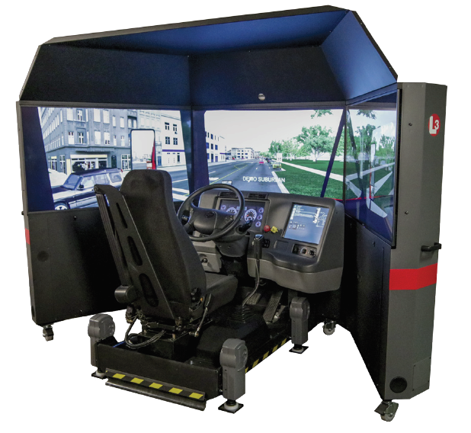
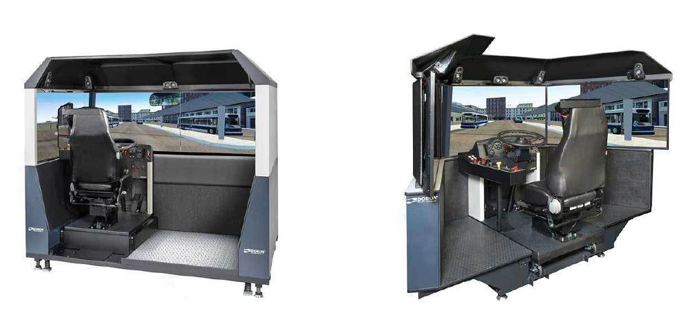
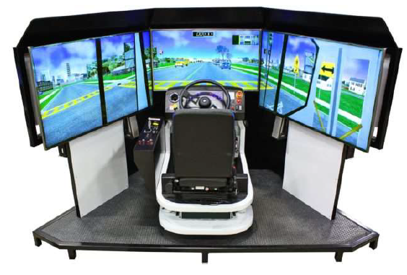
Transit Driving Simulators
Most providers deliver standard curriculum, pre-loaded scenarios, maps, etc.
Providers can provide custom scenarios
Complete solutions available from at least 3 driving simulation vendors
Customizable software and hardware
Widely used
Standard training materials

Slide 11
Transit Driving Simulator Recommendation
Pick one!

Slide 12
Literature Review: Maintenance Operator Simulation
Limited or no commercial simulators for tractor operators
Even less evidence of commercial simulators for rollover prevention
Range of Agricultural and Construction Simulation platforms
Earth movers, cranes, front-end loaders, etc.
No farm tractors
Recent research on Tractor Roll Over Protection Systems and driving simulators
Kihl and Wolf – Snowplow simulators
Gonzalez et al
Llaras et al

Slide 13
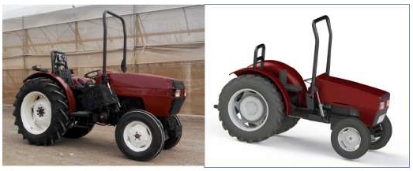
Gonzalez, et al, 2017 – Tractor Driving Simulator
EU research project
40% of serious injuries and deaths in tractor rollover occurred when foldable ROPS was not deployed
Project developed a VR HMD-based simulator to familiarize operators in use of ROPS
Used Gaming Technologies
Built using Unity, NVIDIA PhysX, etc.
Custom motion base developed by University of Valencia
Modeled on CASE IH-2120 Tractor

Slide 14
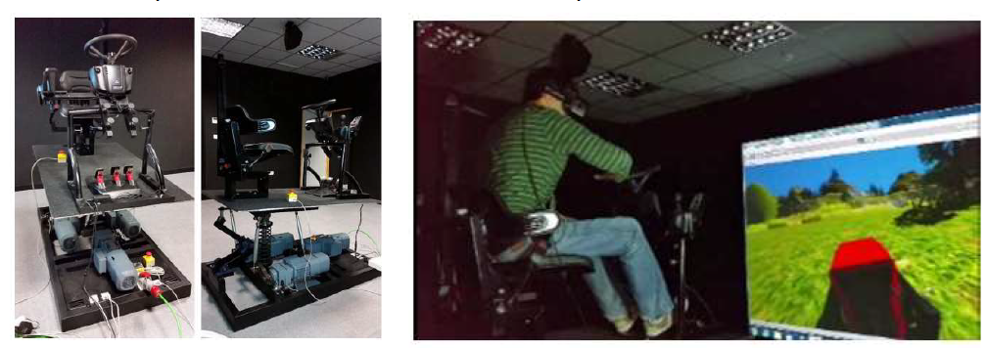
Gonzalez Simulator

Slide 15
Gonzalez Simulator
Participant feedback
Students in training courses made fewer errors in deploying the ROPS
Perception of risk and safety increased after the simulator experience
Participants believe tractor driving simulator can help them drive more safely
All participants considered training to be a very positive experience

Slide 16
Lleras, et al, 2016 – Open source tractor driving simulator
Penn State research project for Northeast Center for Occupational Health and Safety
43% of tractor deaths associated with overturn incidents
Develop simulator for tractor stability tests
Reduce costs associated with driving simulation systems
Viewing directions
Tractor drivers often look to side and rear of vehicle
Simulator must provide 360 degree FOV
Slope – 12 to 15 degrees requires motion base

Slide 17
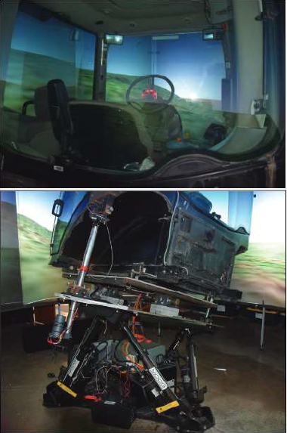
Lleras simulator
360 degree multi-panel screen display
Custom motion base
Based on Moog industrial robot
Electric linear actuators, roll angle sensors
Visuals
Built on robot control software (ROS) and associated simulation software (Gazebo)

Slide 18
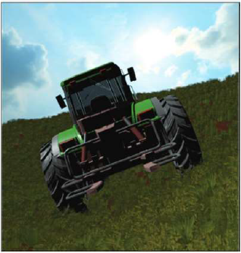
Lleras simulator
Developed custom hardware, software
Expensive hardware
Low upfront cost on software
Limited or no support for software

Slide 19
Tractor operator simulator publications
No further publications from these groups.
Team spoke to both the Gonzalez team and the Lleras team
MARTÍN GÓRRIZ, BERNARDO
b.martin@upct.es
Brennan, Sean N
snb10@psu.edu

Slide 20
Tractor Driving Simulators Requirements Document

Slide 21
Vendor Discussions
11 vendors initially identified
Phone/email interviews followed by detailed technical discussions
Discussions at the 2019 Driving Assessment Conference
4 vendors not interested in pursuing further discussions
4 vendors identified as “willing and (potentially) able”

Slide 22
Tractor Driving Simulator Recommendation
General:
Proven track record
Willingness to take on this project
Demonstrated understanding of the complexity / issues
Ability to partner with HW/SW vendor as necessary
Candidates:
4 vendors selected for next round of discussions

Slide 23
Challenges
No current simulator exists that meet these requirements
Typical driving simulator motion platforms have limited roll angle
Field of view requirements
VR (if used)
Registration with physical world (hands, controls, etc.)
Simulator sickness
Portability
Cost

Slide 24
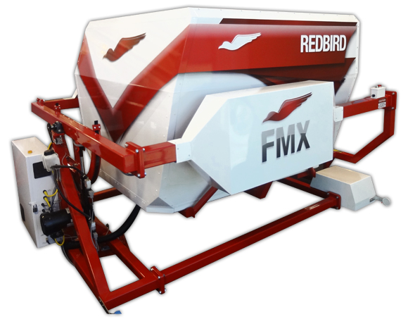
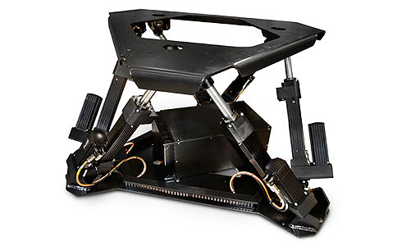
Next?
Tip some tractors!
Get creative!

Slide 25
Thanks to:
Mississippi Department of Transportation
Cindy Smith
Rhea Vincent
All the Women and Men who keep our highways maintained and beautiful
All the Women and Men who keep our bus systems running

Slide 26
Thank YOU!

